Slide 1

DATA Exploration and Cleaning using python
Eng. Fatma Gamal

Slide 2

NumPy Arrays
NumPy implements a data structure called the N-dimensional array or ndarray.
ndarrays are like lists in that they contain a collection of items that can be accessed via indexes.
ndarrays are homogeneous, meaning they can only contain objects of the same type.
ndarrays can be multi-dimensional, making it easy to store 2-dimensional tables or matrices.

Slide 3
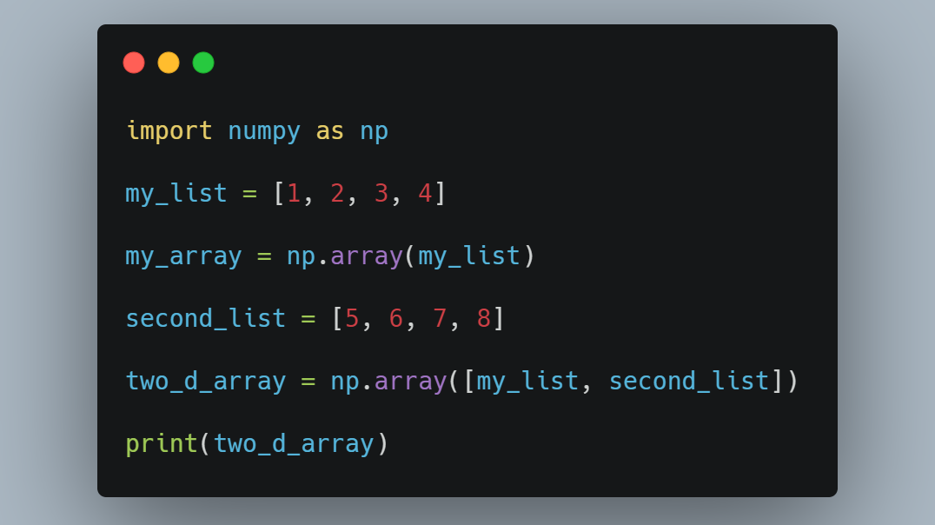

Slide 4
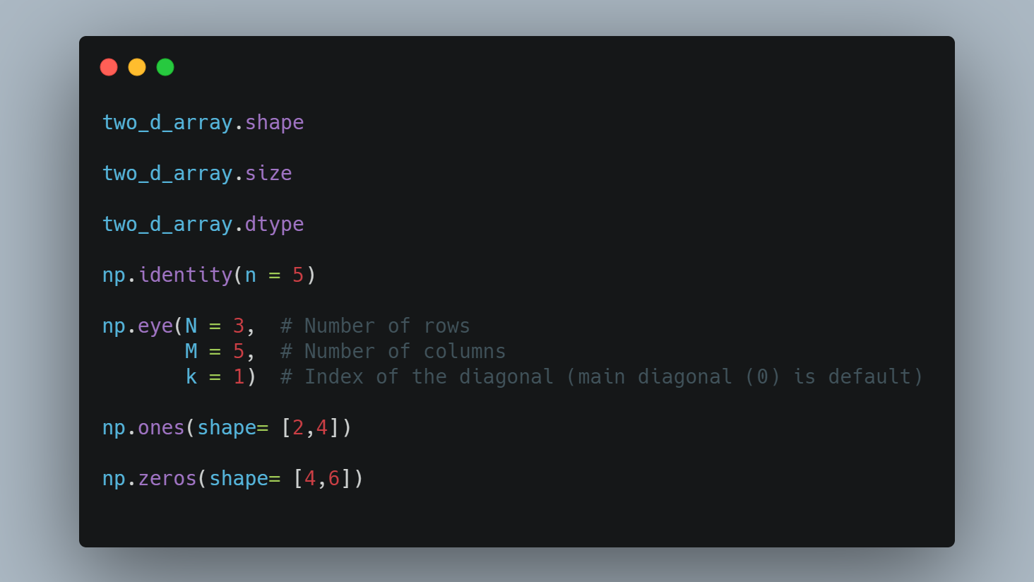

Slide 5
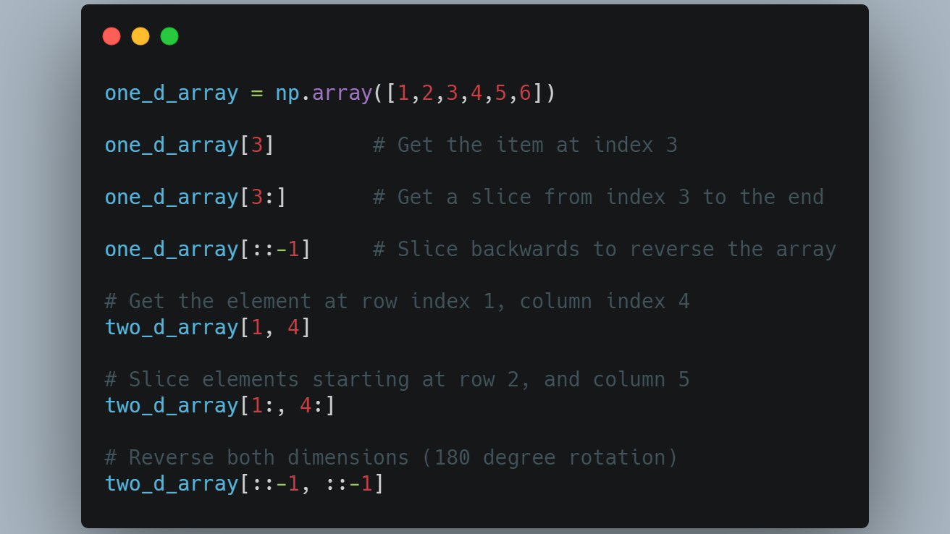

Slide 6
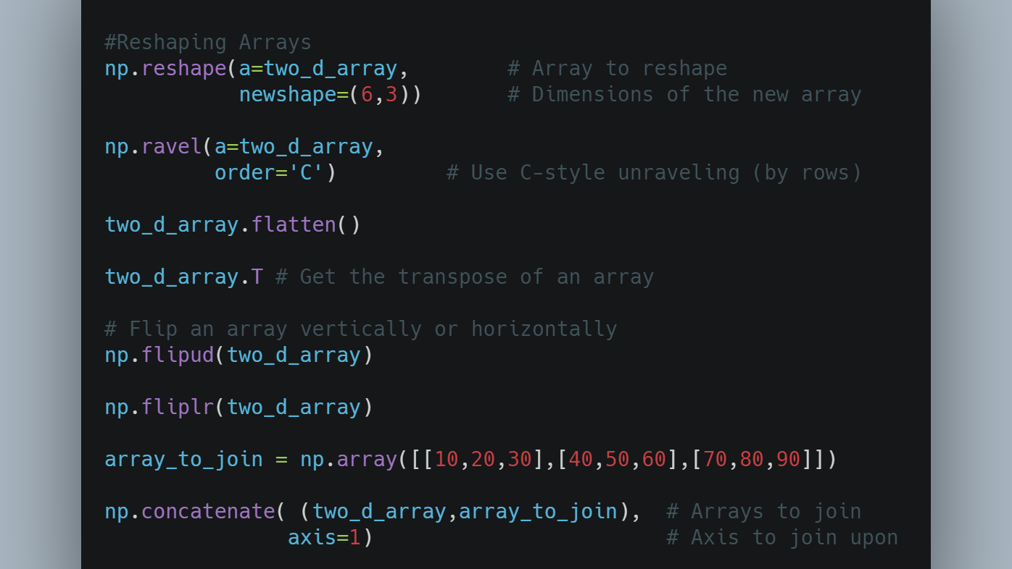

Slide 7
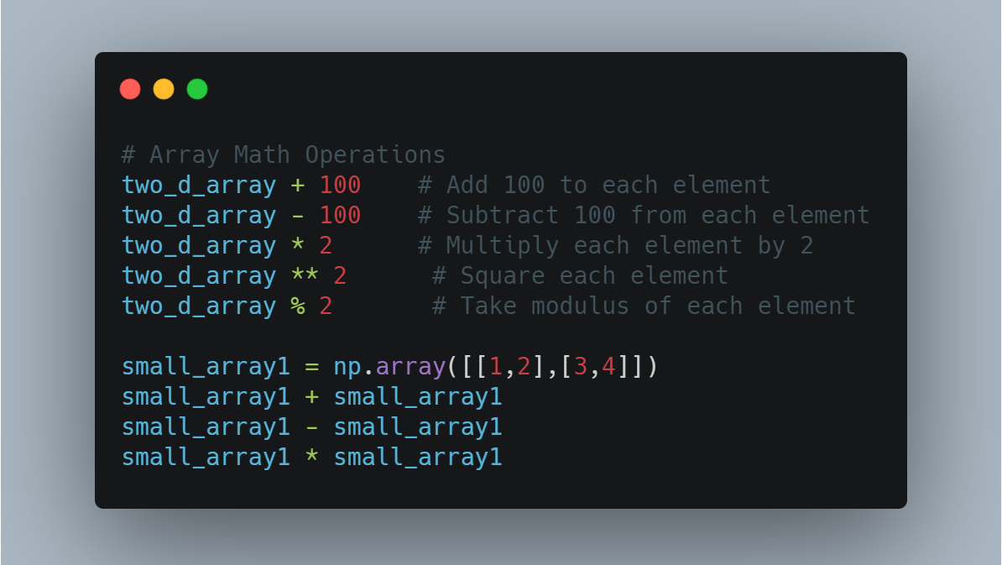

Slide 8
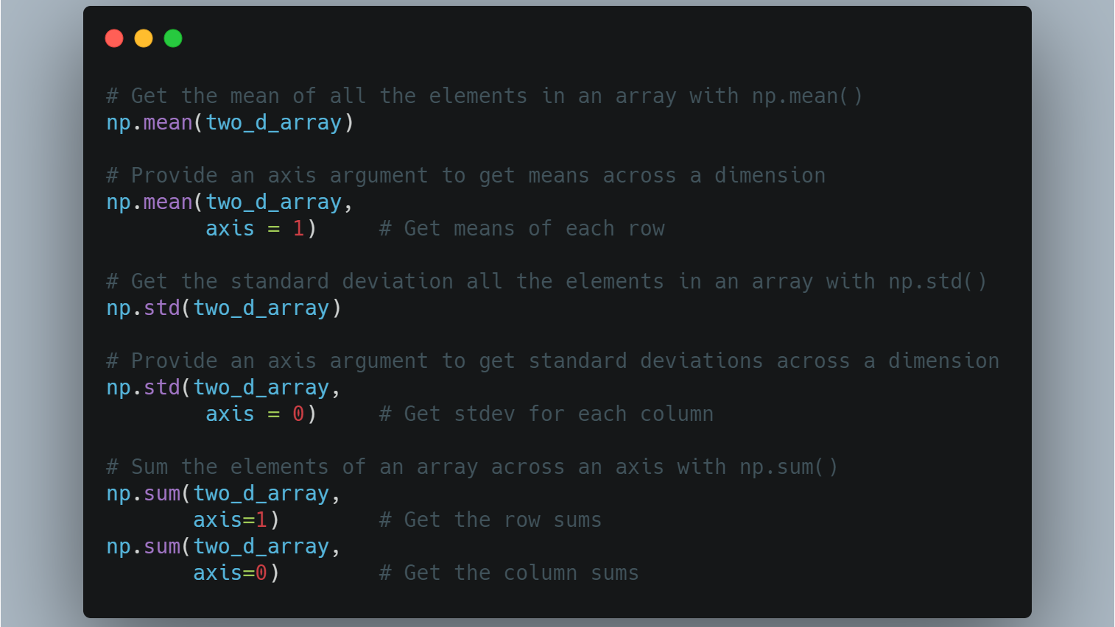

Slide 9
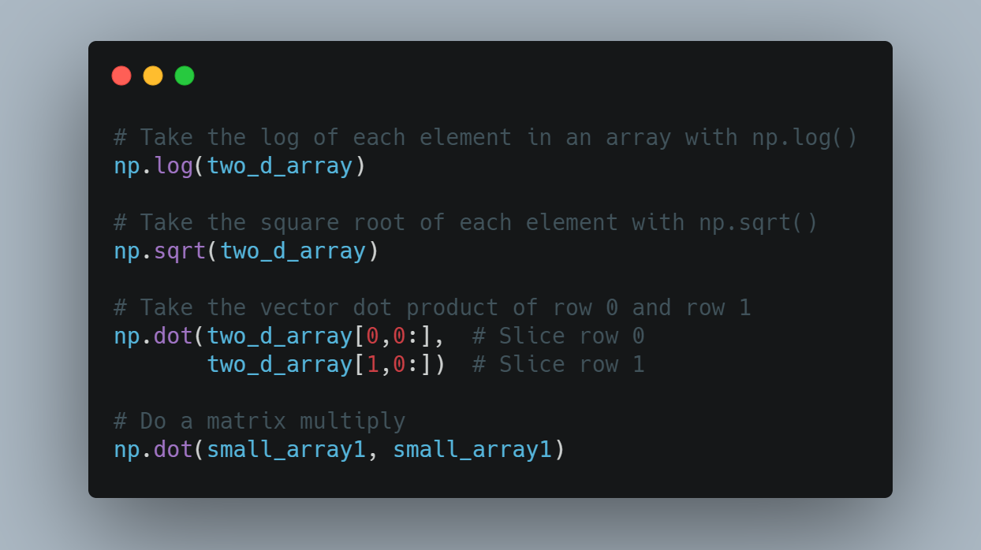

Slide 10

Pandas DataFrames
To store data from an external source like an excel workbook or database, we need a data structure that can hold different data types.
The pandas library offers data structures designed with this in mind: the series and the DataFrame. Series are 1-dimensional labeled arrays similar to numpy's ndarrays, while DataFrames are labeled 2-dimensional structures, that essentially function as spreadsheet tables.

Slide 11
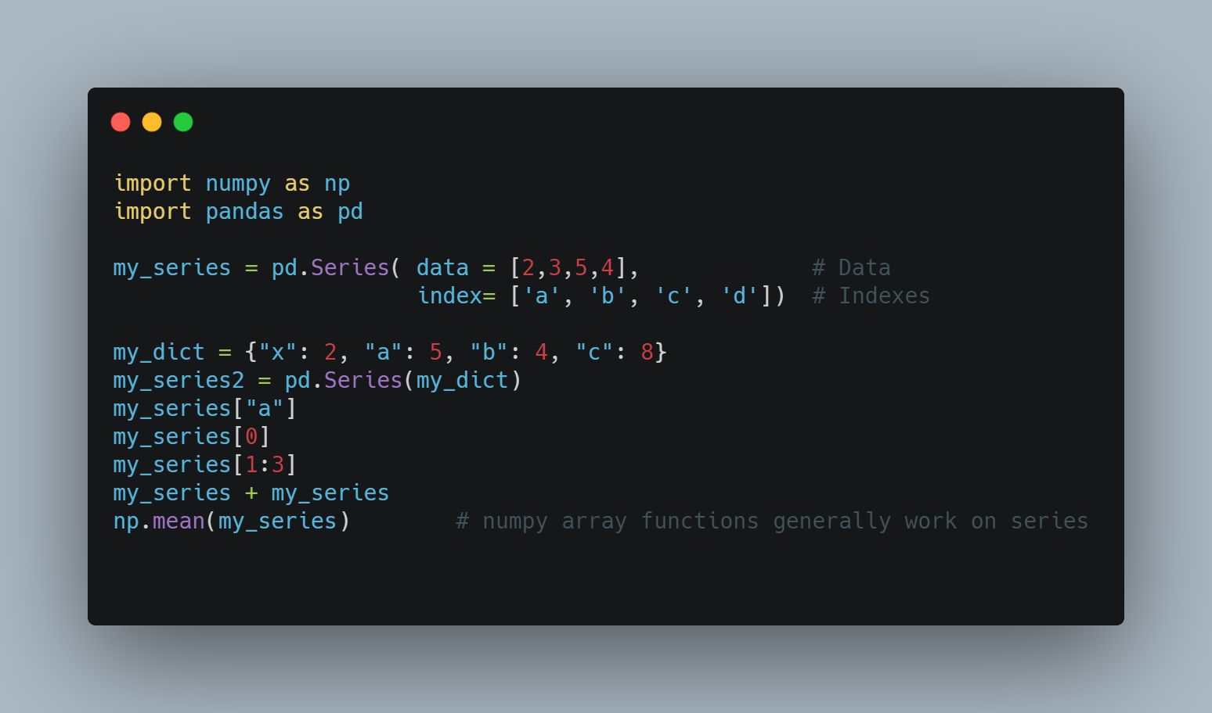

Slide 12
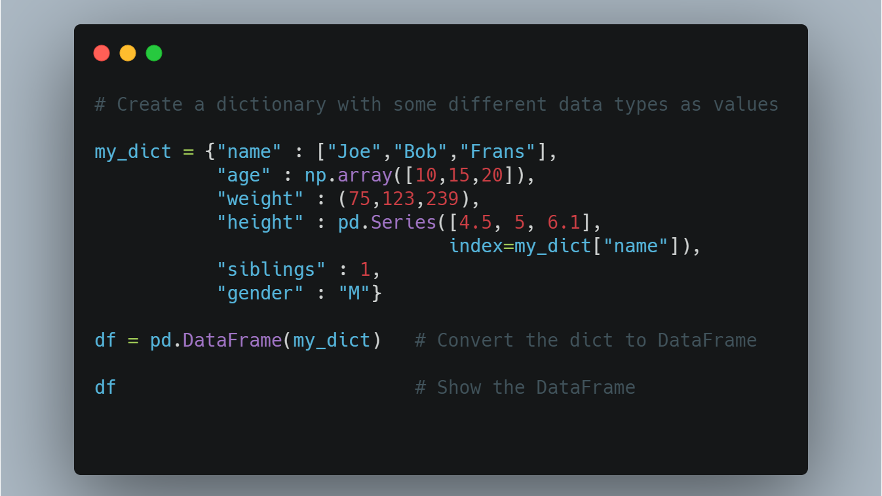

Slide 13
 | name | age | weight | height | siblings | gender
Joe | Joe | 10 | 75 | 4.5 | 1 | M
Bob | Bob | 15 | 123 | 5.0 | 1 | M
Frans | Frans | 20 | 239 | 6.1 | 1 | M

Slide 14
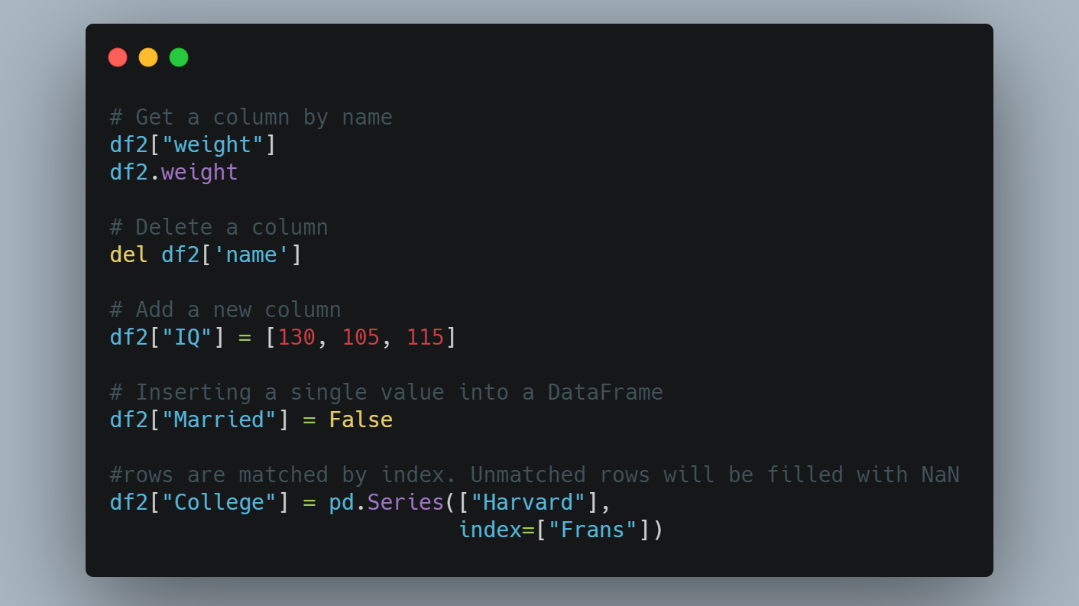

Slide 15
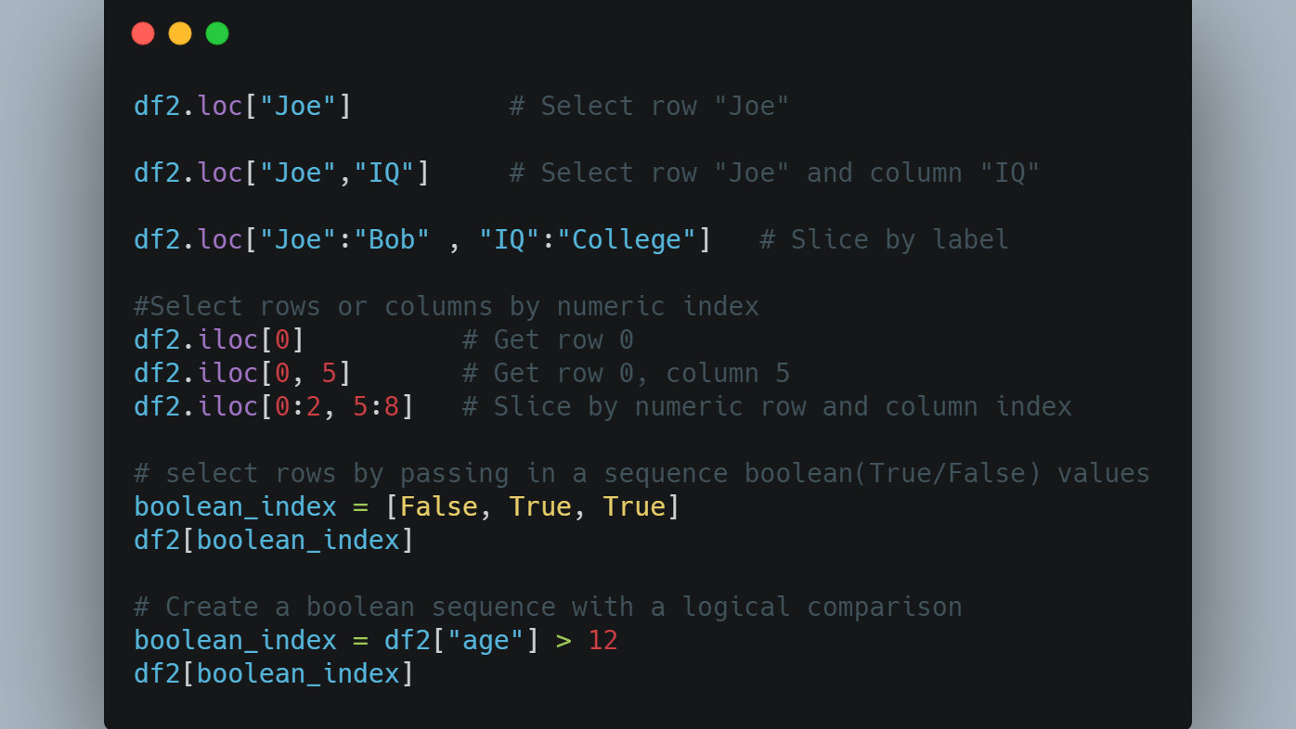

Slide 16
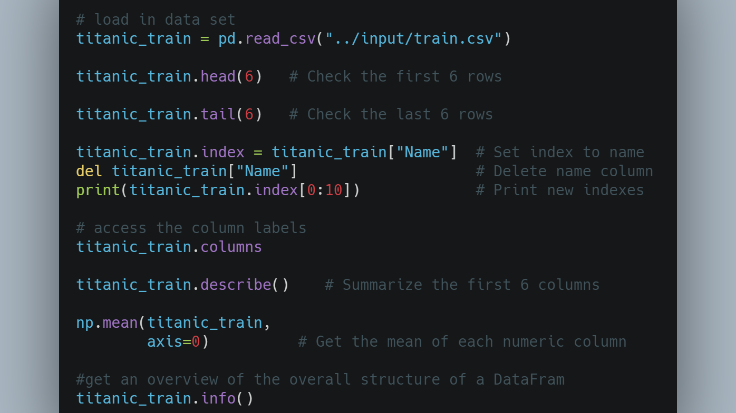

Slide 17
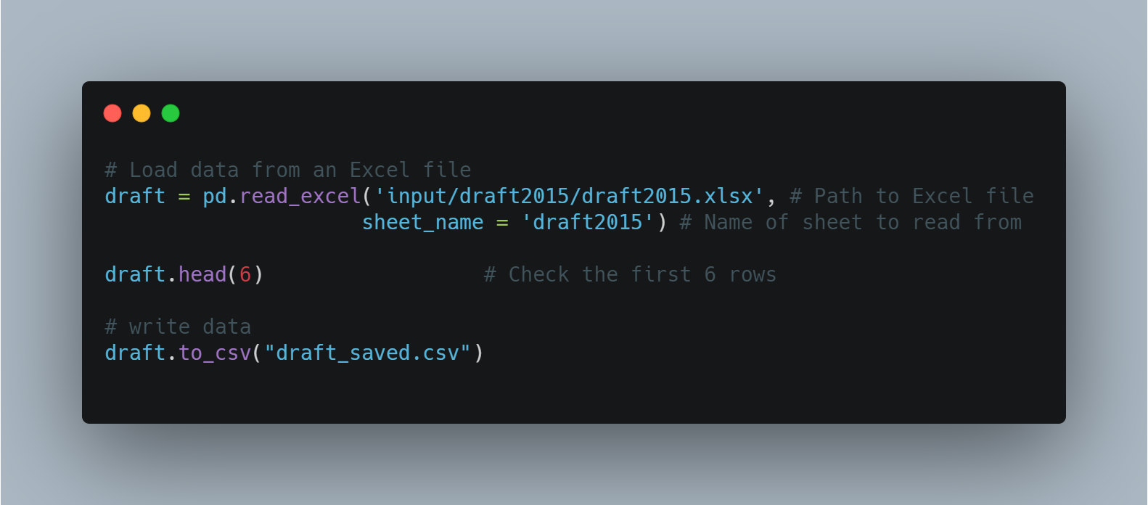

Slide 18

Data Exploration and Cleaning
The first part of any data analysis or predictive modeling task is an initial exploration of the data. it is important to explore the data before doing any serious analysis, since oddities in the data can cause bugs and muddle your results.

Slide 19
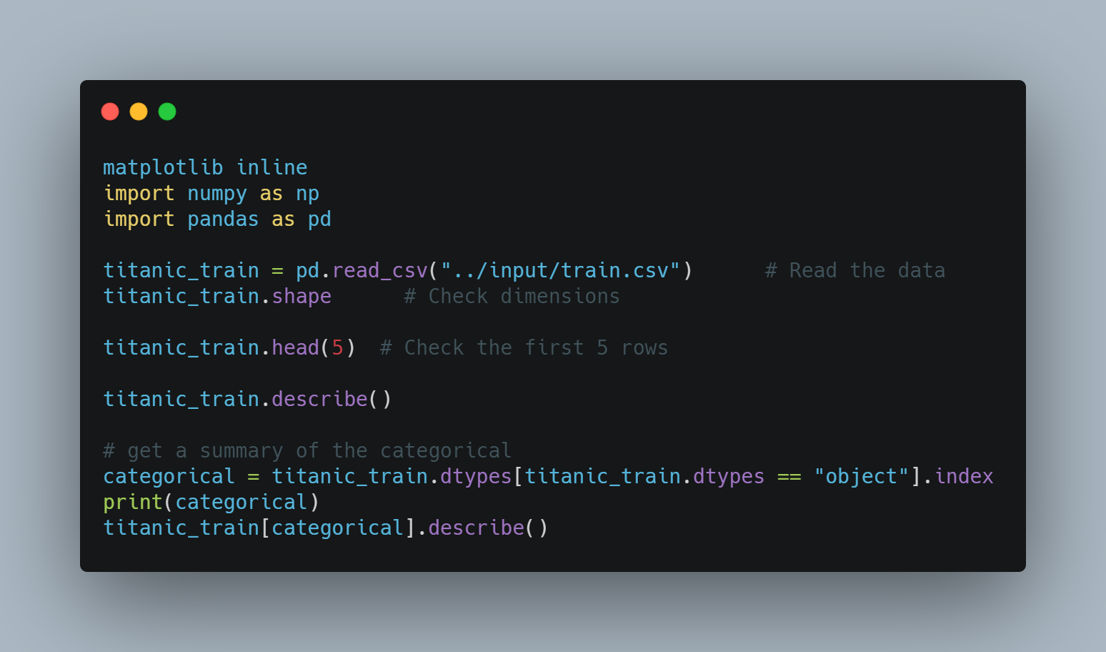

Slide 20

Data Exploration and Cleaning (Cont.)
After looking at the data for the first time, you should ask yourself a few questions:
Do I need all the variables?
Should I transform any variables?
Are there NA values, outliers or other strange values?
Should I create new variables?

Slide 21
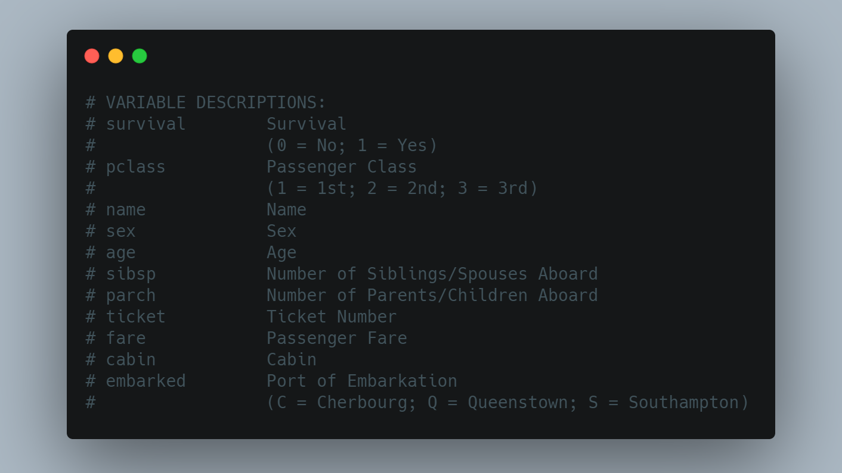

Slide 22
Do I Need All of the Variables?
the goal is to use the training data to predict whether passengers of the titanic listed in a second data set survived or not.
"PassengerId" is just a number assigned to each passenger. It is nothing more than an arbitrary identifier.
"Survived" indicates whether each passenger lived or died. Since predicting survival is our goal, we need to keep it.
Features that describe passengers numerically or group them into a few broad categories could be useful for predicting survival. The variables Pclass, Sex, Age, SibSp, Parch, Fare and Embarked appear to fit this description, so let's keep all of them.

Slide 23
Do I Need All of the Variables? (Cont.)
the Name variable has 889 unique values. Since there are 889 rows in the data set we know each name is unique.
the Name variable could be removed. On the other hand, it can be nice to have some way to uniquely identify cases and names are interesting from a personal and historical perspective, so let's keep Name

Slide 24
Do I Need All of the Variables? (Cont.)
Ticket has 680 unique values: almost as many as there are passengers. Categorical variables with almost as many levels as there are records are often not very useful for prediction.
The ticket numbers don't appear to follow any logical pattern we could use for grouping. Let's remove it
Cabin also has 145 unique values, which indicates it may not be particularly useful for prediction. On the other hand, the names of the levels for the cabin variable seem to have a regular structure: each starts with a capital letter followed by a number.

Slide 25
Should I Transform Any Variables?
When you first load a data set, some of the variables may be encoded as data types that don't fit well with what the data really is or what it means.
Variables that indicate a state or the presence or absence of something with the numbers 0 and 1 are sometimes called indicator variables or dummy variables.
Survived is just an integer variable that takes on the value 0 or 1 depending on whether a passenger died or survived, respectively. However, the predictions need to be encoded as 0 or 1.
Pclass is an integer that indicates a passenger's class, with 1 being first class, 2 being second class and 3 being third class.

Slide 26
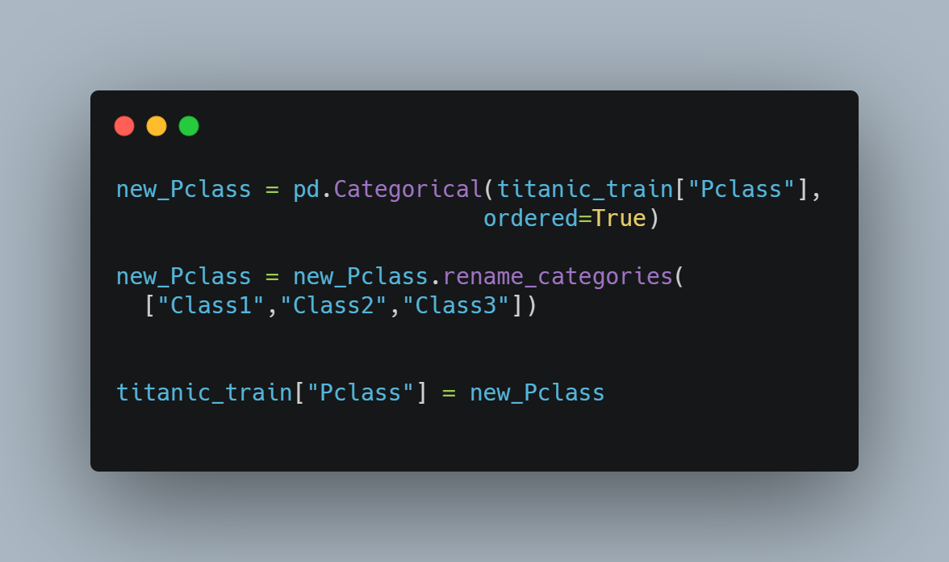

Slide 27

Should I Transform Any Variables? (Cont.)
the Cabin variable appears that each Cabin is in a general section of the ship indicated by the capital letter at the start of each factor level.

Slide 28
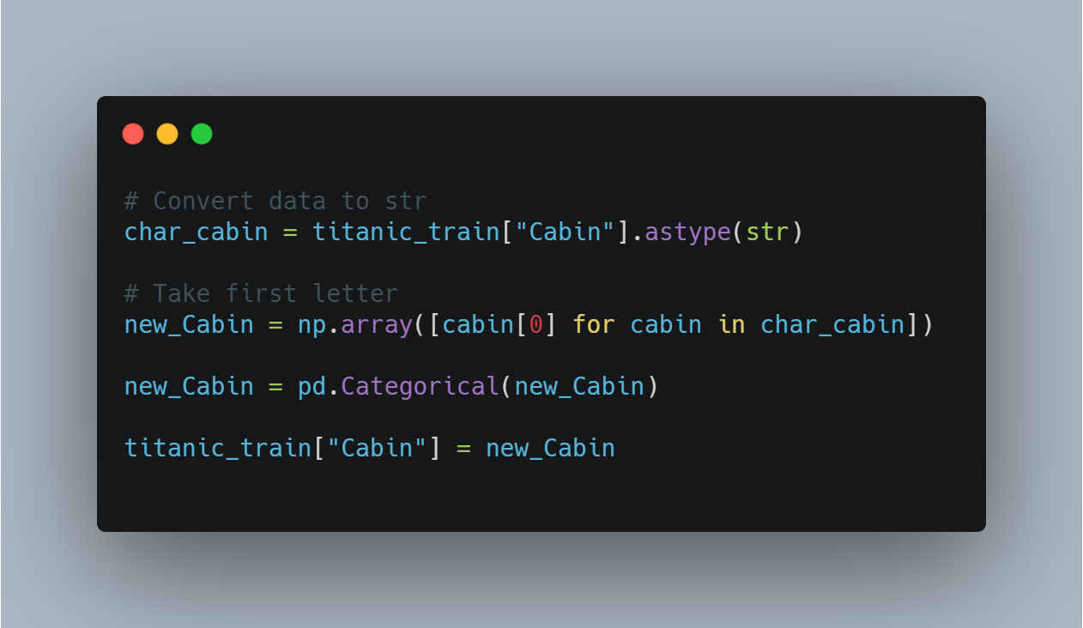

Slide 29

Are there NA Values, Outliers or Other Strange Values?
Data sets are often littered with missing data, extreme data points called outliers and other strange values. Missing values, outliers and strange values can negatively affect statistical tests and models and may even cause certain functions to fail.

Slide 30
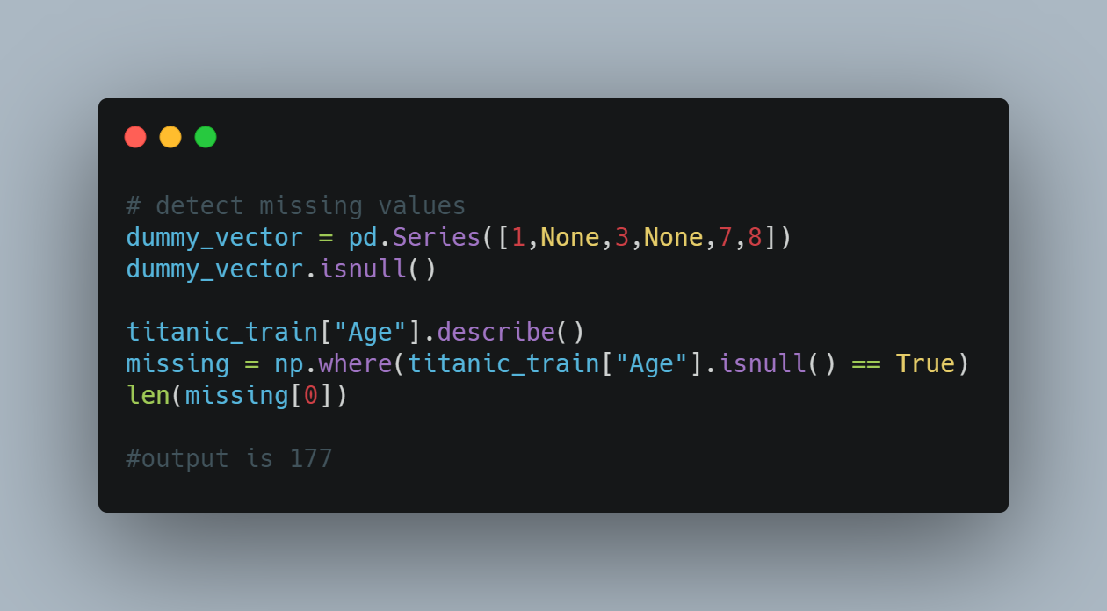

Slide 31
Are there NA Values, Outliers or Other Strange Values?
Replace the null values with 0s
Replace the null values with some central value like the mean or median
Impute some other value (estimating age based on other variables)
Split the data set into two parts: one set with where records have an Age value and another set where age is null.

Slide 32
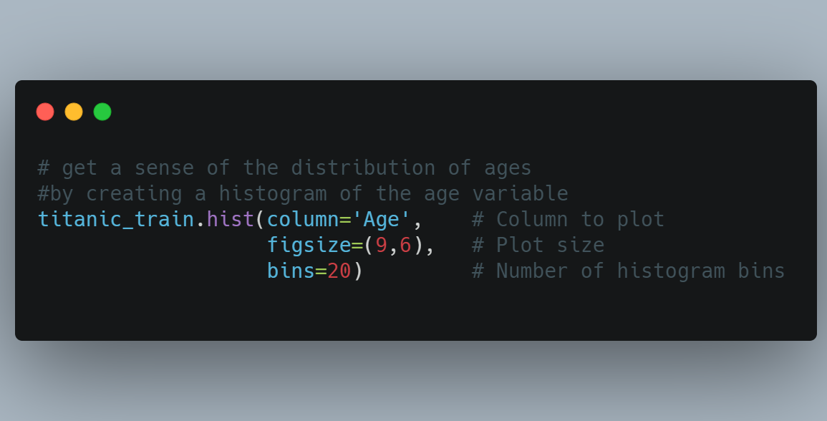

Slide 33
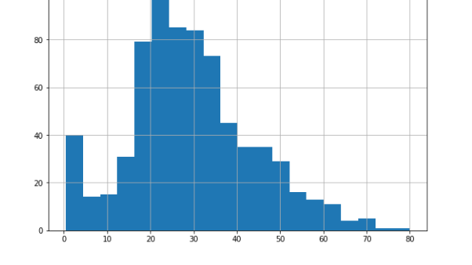

Slide 34
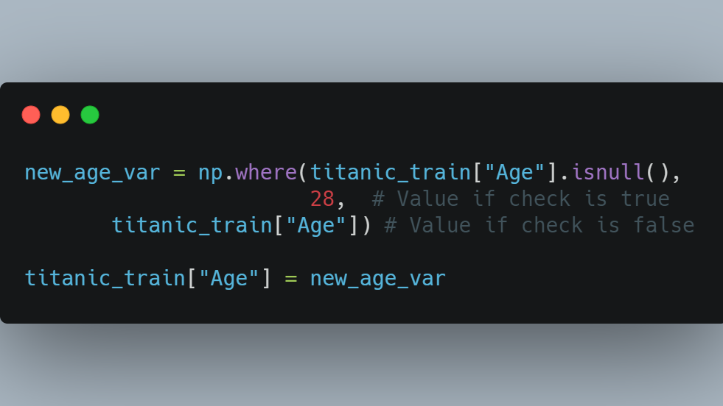

Slide 35
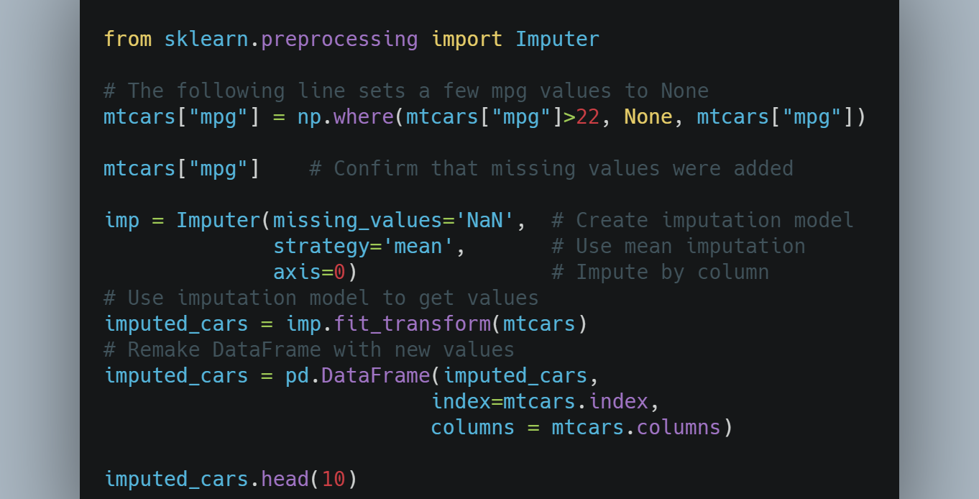

Slide 36

Are there NA Values, Outliers or Other Strange Values? (Cont.)
Outliers are extreme numerical values: values that lie far away from the typical values a variable takes on.
Creating plots is one of the quickest ways to detect outliers.
Use boxplot of the "Fare" variable, since boxplots are designed to show the spread of the data and help identify outliers.
You can keep them, delete them or transform them in some way to try to reduce their impact.

Slide 37
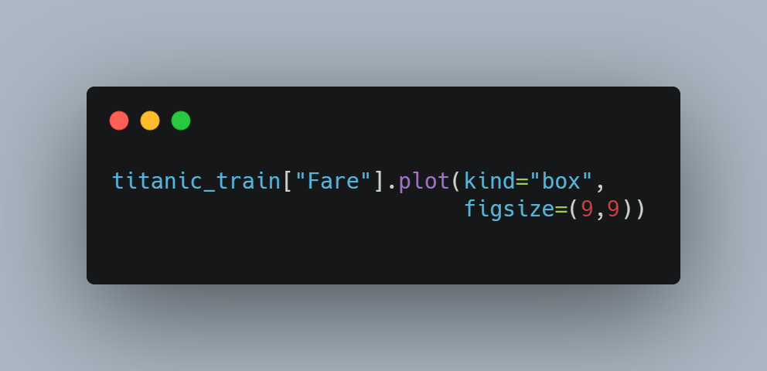

Slide 38
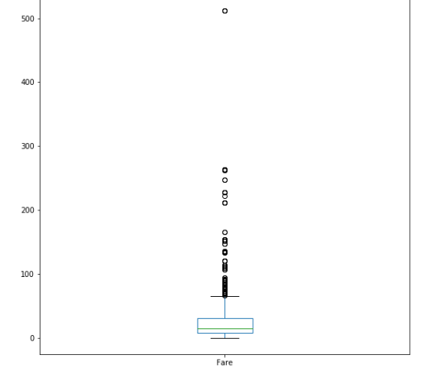

Slide 39
Should I Create New Variables?
Creating new variables that are derivations or combinations existing ones is a common step to take before jumping into an analysis or modeling task.
Family, that combines SibSp and Parch to indicate the total number of family members (siblings, spouses, parents and children) a passenger has on board.

Slide 40
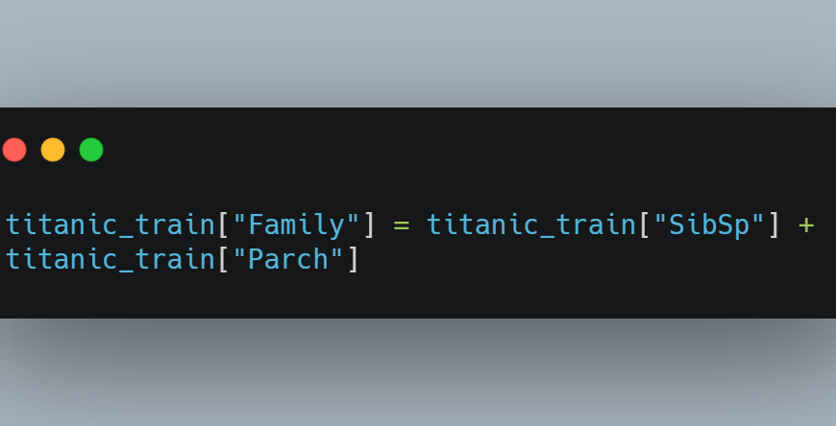

Slide 41

Working With Text Data
Text data can be extremely messy and difficult to work with because it can contain all sorts of characters and symbols that may have little meaning for your analysis.

Slide 42
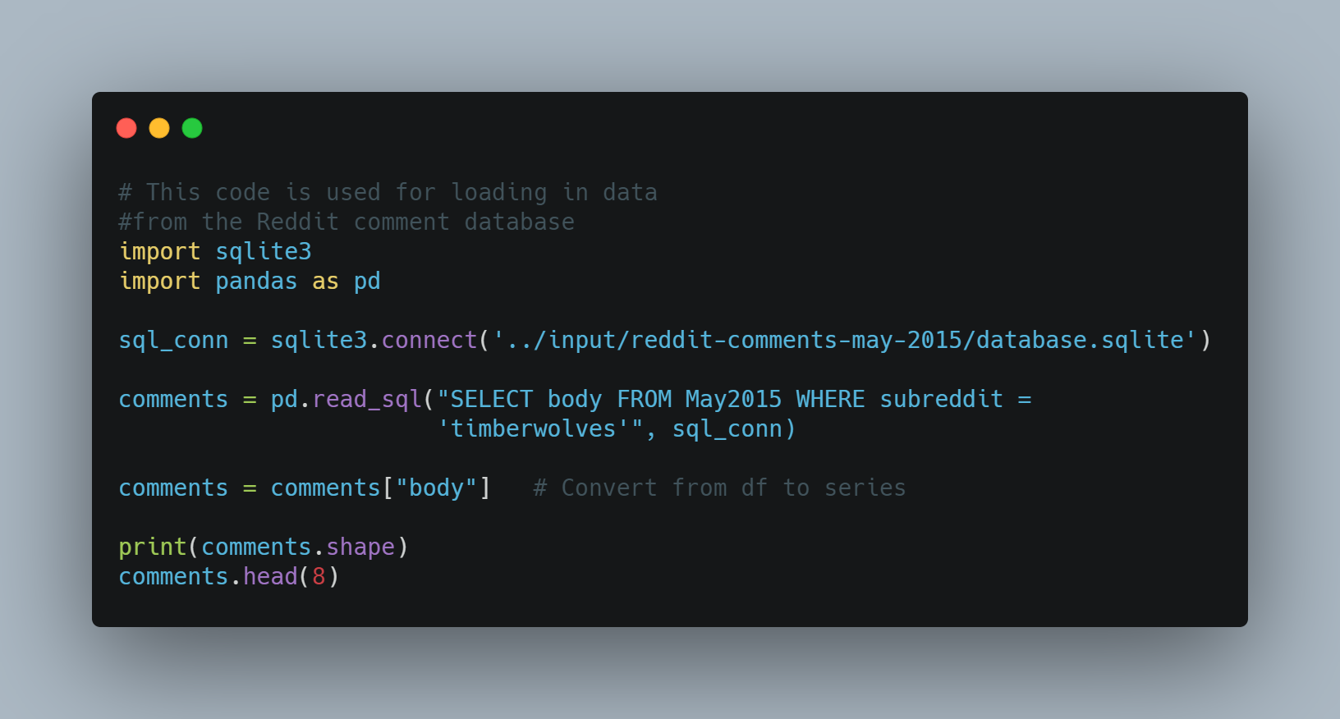

Slide 43
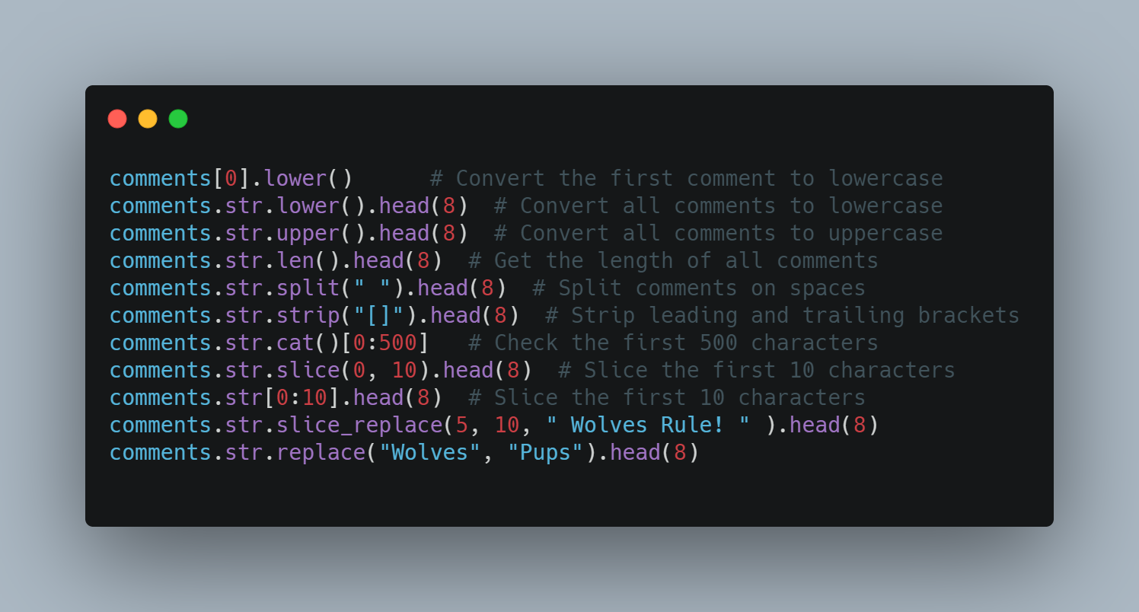

Slide 44
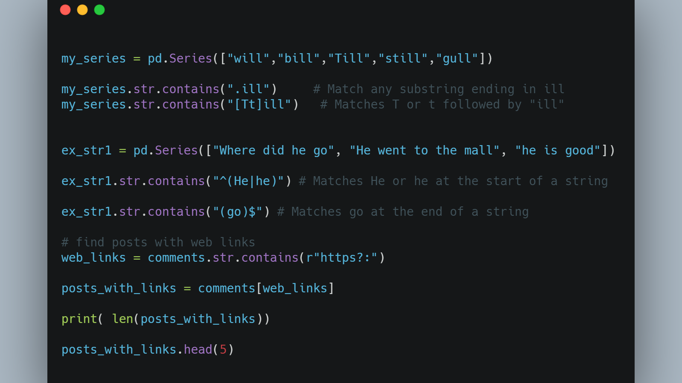

Slide 45
Preparing Numeric Data
Numeric data tends to be better-behaved than text data. There's only so many symbols that appear in numbers and they have well-defined values.
Numeric variables are often on different scales and cover different ranges, so they can't be easily compared.
variables with large values can dominate those with smaller values when using certain modeling techniques.

Slide 46
Preparing Numeric Data (Cont.)
Centering and scaling is a common preprocessing task that puts numeric variables on a common scale so no single variable will dominate the others.
The simplest way to center data is to subtract the mean value from each data point. It centers the data around zero and sets the new mean to zero.
One way to put data on a common scale is to divide by the standard deviation.

Slide 47
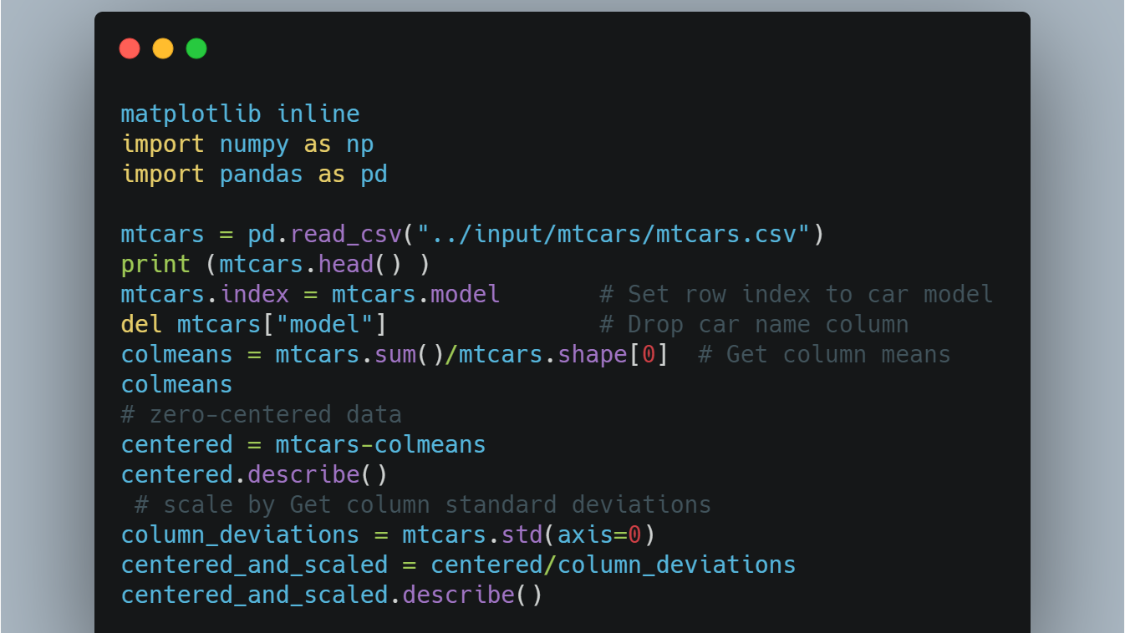

Slide 48
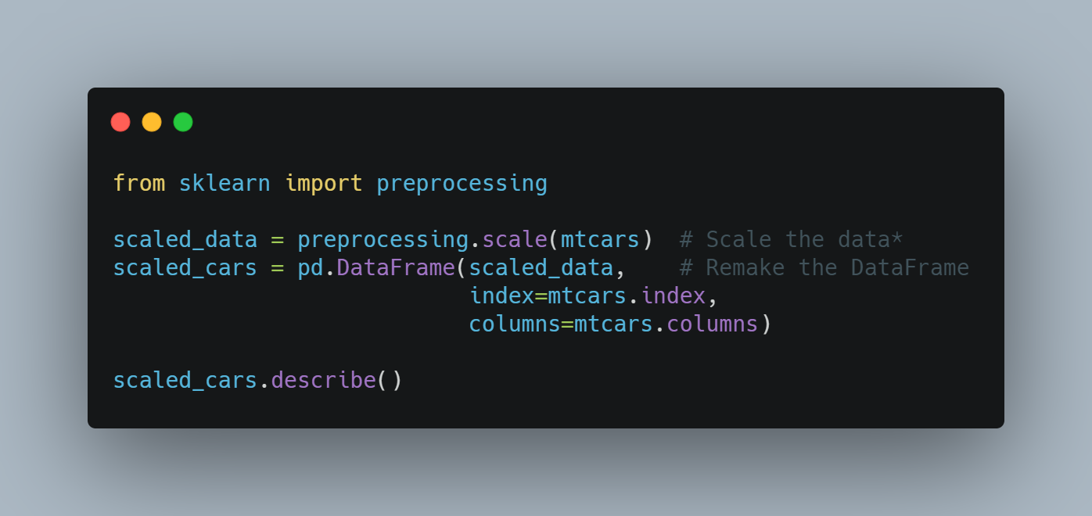

Slide 49
Preparing Numeric Data (Cont.)
The distribution of data (its overall shape and how it is spread out) can have a significant impact on analysis and modeling.
Data that is roughly evenly spread around the mean value known as normally distributed data tends to be well-behaved.
On the other hand, some data sets exhibit significant skewness or asymmetry.
Data with a long tail that goes off to the right is called positively skewed or right skewed.
Taking the square root of each data point or taking the natural logarithm of each data point are two simple transformations that can reduce skew.

Slide 50
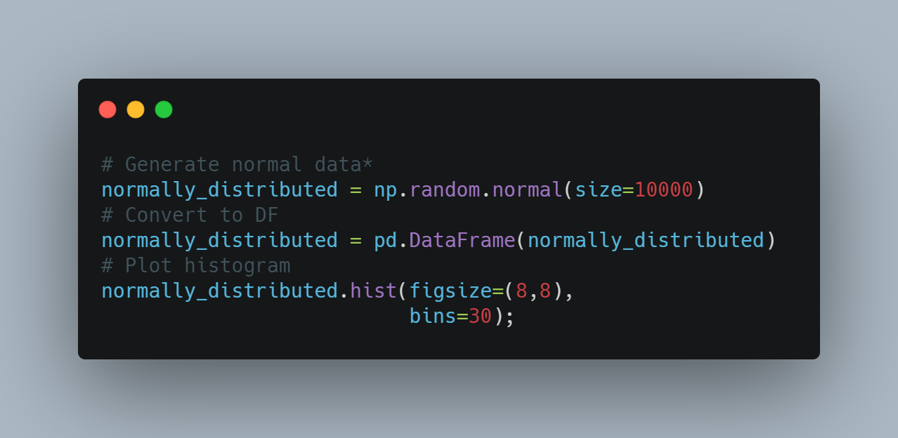

Slide 51
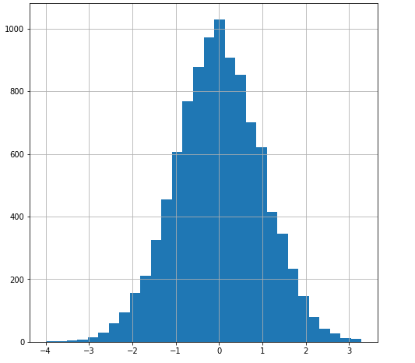

Slide 52
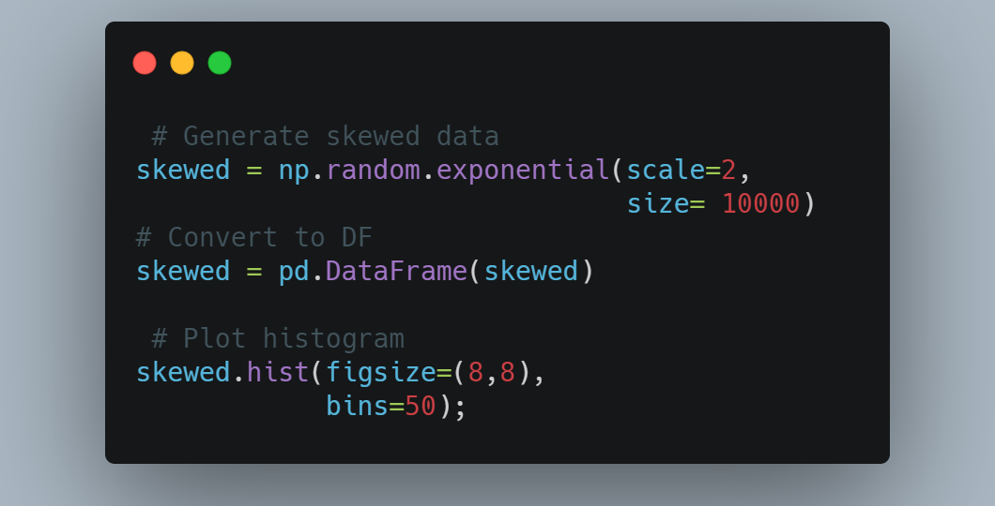

Slide 53
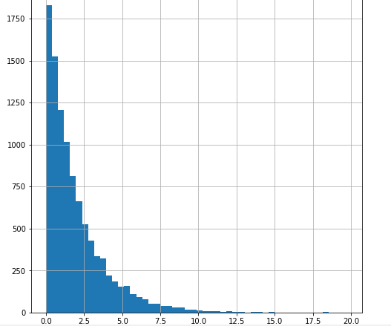

Slide 54
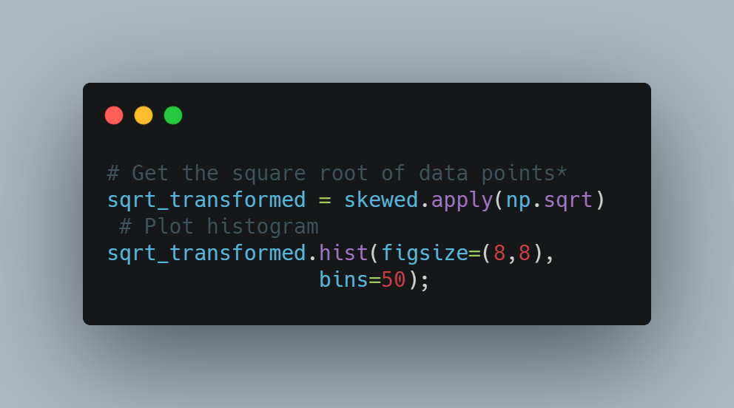

Slide 55
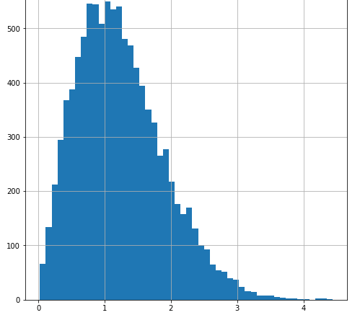

Slide 56
Preparing Numeric Data (Cont.)
In predictive modeling, each variable you use to construct a model would ideally represent some unique feature of the data. In other words, you want each variable to tell you something different. In reality, variables often exhibit collinearity.
Variables with strong correlations can interfere with one another when performing modeling and muddy results.
A positive correlation implies that when one variable goes up the other tends to go up as well. Negative correlations indicate an inverse relationship. A correlation near zero indicates low correlation while a correlation near -1 or 1 indicates a large negative or positive correlation.

Slide 57
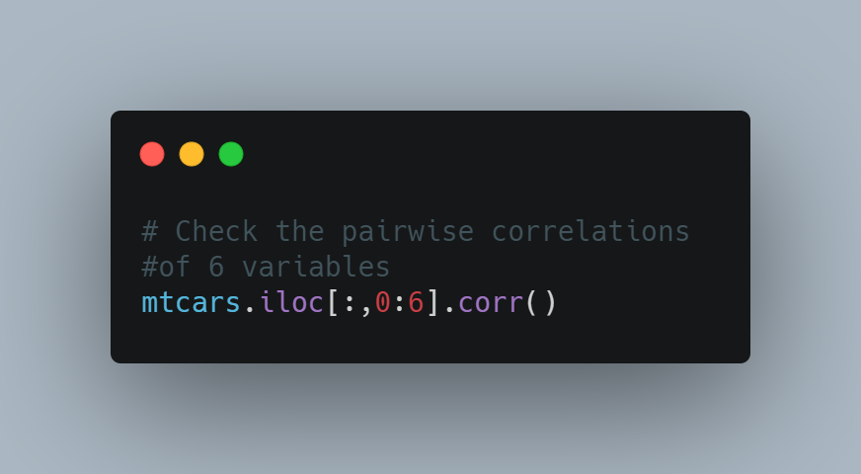

Slide 58
 | mpg | cyl | disp | hp | drat | wt
mpg | 1.000000 | -0.852162 | -0.847551 | -0.776168 | 0.681172 | -0.867659
cyl | -0.852162 | 1.000000 | 0.902033 | 0.832447 | -0.699938 | 0.782496
disp | -0.847551 | 0.902033 | 1.000000 | 0.790949 | -0.710214 | 0.887980
hp | -0.776168 | 0.832447 | 0.790949 | 1.000000 | -0.448759 | 0.658748
drat | 0.681172 | -0.699938 | -0.710214 | -0.448759 | 1.000000 | -0.712441
wt | -0.867659 | 0.782496 | 0.887980 | 0.658748 | -0.712441 | 1.000000

Slide 59
Preparing Numeric Data (Cont.)
Inspecting the data table, we see that the number of cylinders a car has (cyl) and its weight (wt) have fairly strong negative correlations to gas mileage (mpg.). This indicates that heavier cars and cars with more cylinders tend to get lower gas mileage.
If you find highly correlated variables, there are a few things you can do including:
Leave them be
Remove one or more variables
Combine them in some way

Slide 60

Dealing With Dates
Common date formats contain numbers and sometimes text as well to specify months and days.
Getting dates into a friendly format and extracting features of dates like month and year into new variables can be useful preprocessing steps.

Slide 61
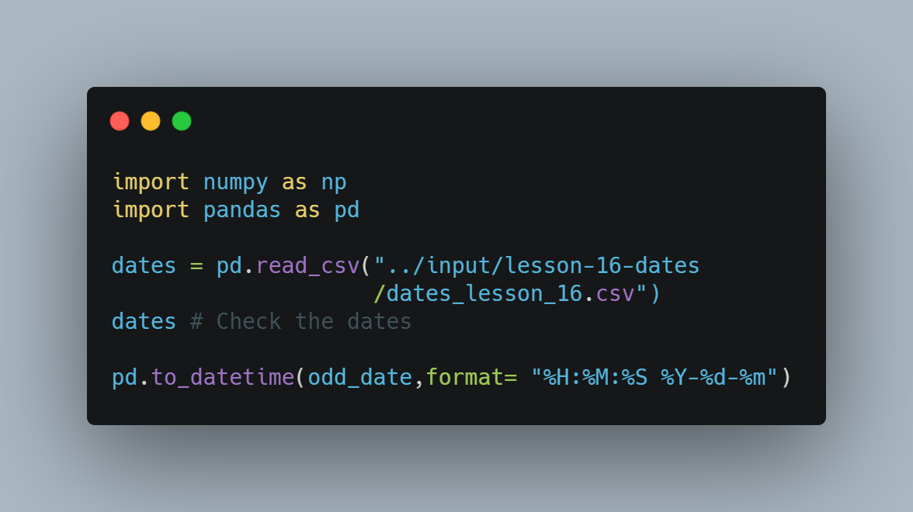

Slide 62
 | month_day_year | day_month_year | date_time | year_month_day
0 | 04/22/96 | 22-Apr-96 | Tue Aug 11 09:50:35 1996 | 2007-06-22
1 | 04/23/96 | 23-Apr-96 | Tue May 12 19:50:35 2016 | 2017-01-09
2 | 05/14/96 | 14-May-96 | Mon Oct 14 09:50:35 2017 | 1998-04-12
3 | 05/15/96 | 15-May-96 | Tue Jan 11 09:50:35 2018 | 2027-07-22
4 | 05/16/01 | 16-May-01 | Fri Mar 11 07:30:36 2019 | 1945-11-15
5 | 05/17/02 | 17-May-02 | Tue Aug 11 09:50:35 2020 | 1942-06-22
6 | 05/18/03 | 18-May-03 | Wed Dec 21 09:50:35 2021 | 1887-06-13
7 | 05/19/04 | 19-May-04 | Tue Jan 11 09:50:35 2022 | 1912-01-25
8 | 05/20/05 | 20-May-05 | Sun Jul 10 19:40:25 2023 | 2007-06-22

Slide 63
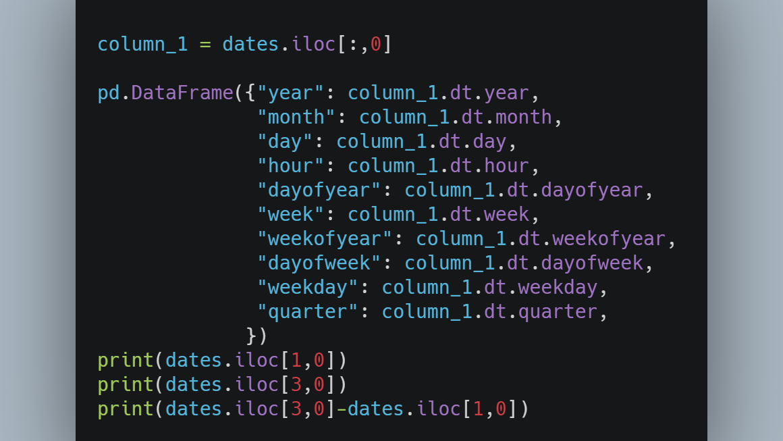

Slide 64
Merging Data
Data you use for your projects won't always be confined to a single table in a CSV or excel file.
Data is often split across several tables that you need to combine in some way. DataFrames can be joined together if they have columns in common.

Slide 65
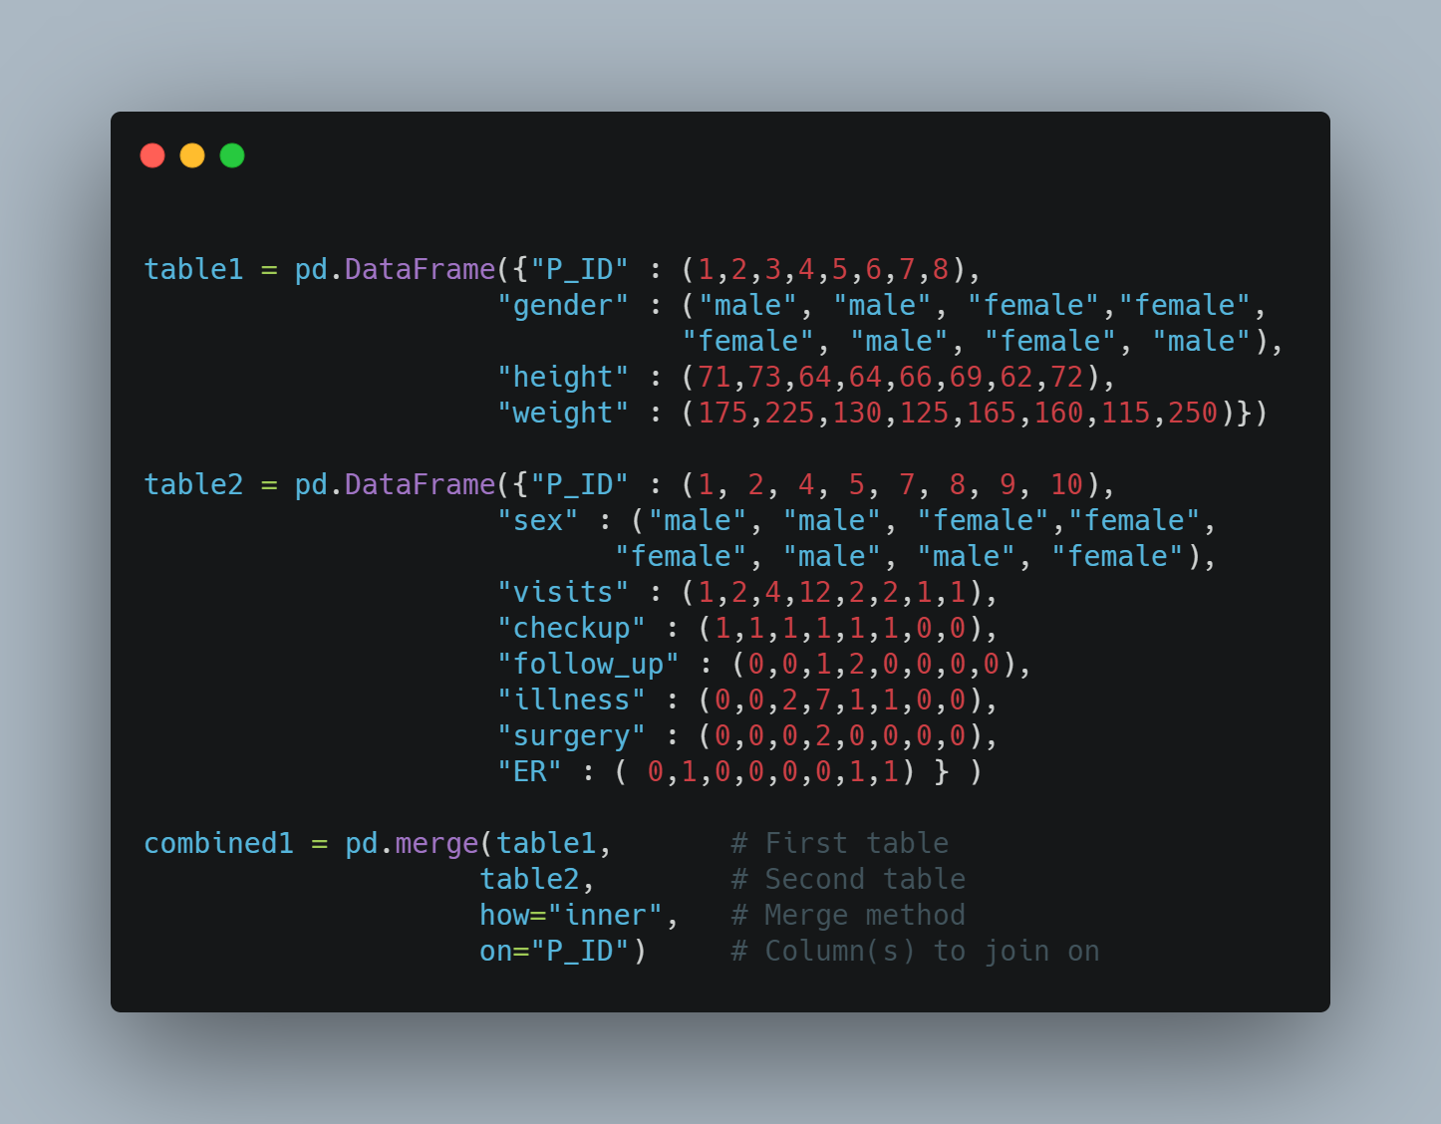

Slide 66
 | P_ID | gender | height | weight | sex | visits | checkup | follow_up | illness | surgery | ER
0 | 1 | male | 71 | 175 | male | 1 | 1 | 0 | 0 | 0 | 0
1 | 2 | male | 73 | 225 | male | 2 | 1 | 0 | 0 | 0 | 1
2 | 4 | female | 64 | 125 | female | 4 | 1 | 1 | 2 | 0 | 0
3 | 5 | female | 66 | 165 | female | 12 | 1 | 2 | 7 | 2 | 0
4 | 7 | female | 62 | 115 | female | 2 | 1 | 0 | 1 | 0 | 0
5 | 8 | male | 72 | 250 | male | 2 | 1 | 0 | 1 | 0 | 0

Slide 67
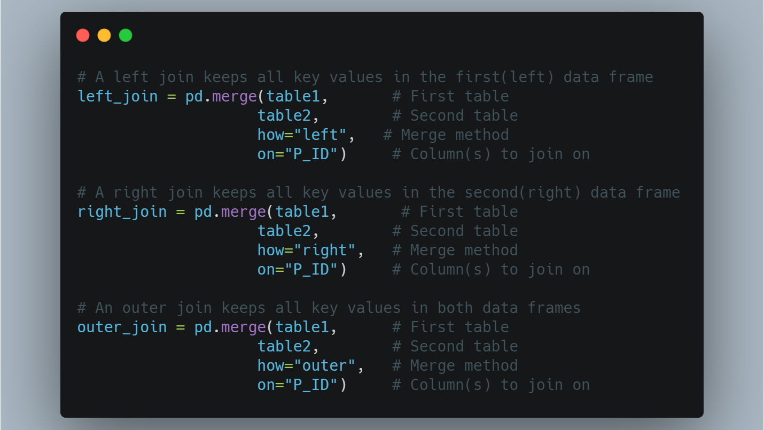

Slide 68
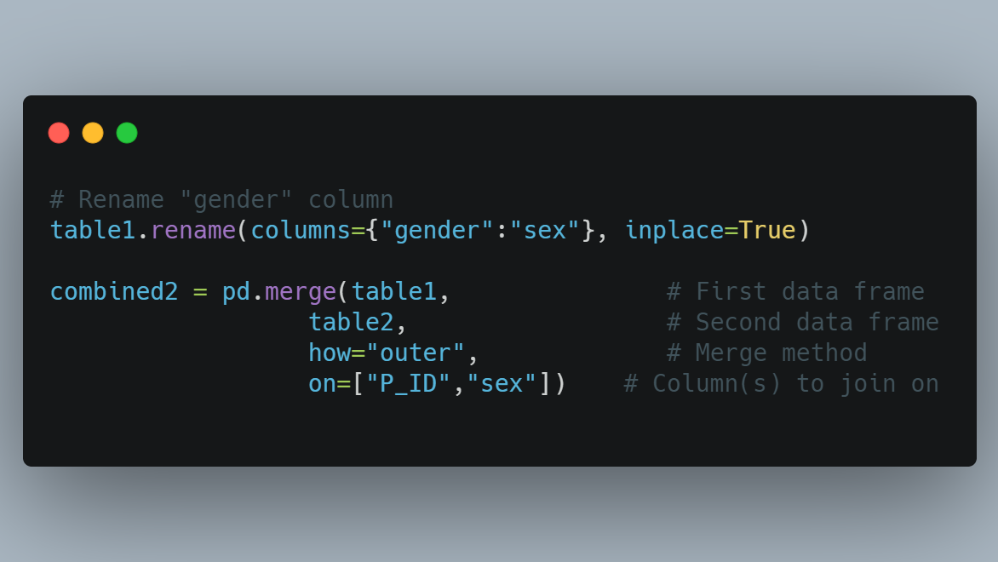

Slide 69
Frequency Tables
Frequency tables are a basic tool you can use to explore data and get an idea of the relationships between variables.
A frequency table is just a data table that shows the counts of one or more categorical variables.

Slide 70
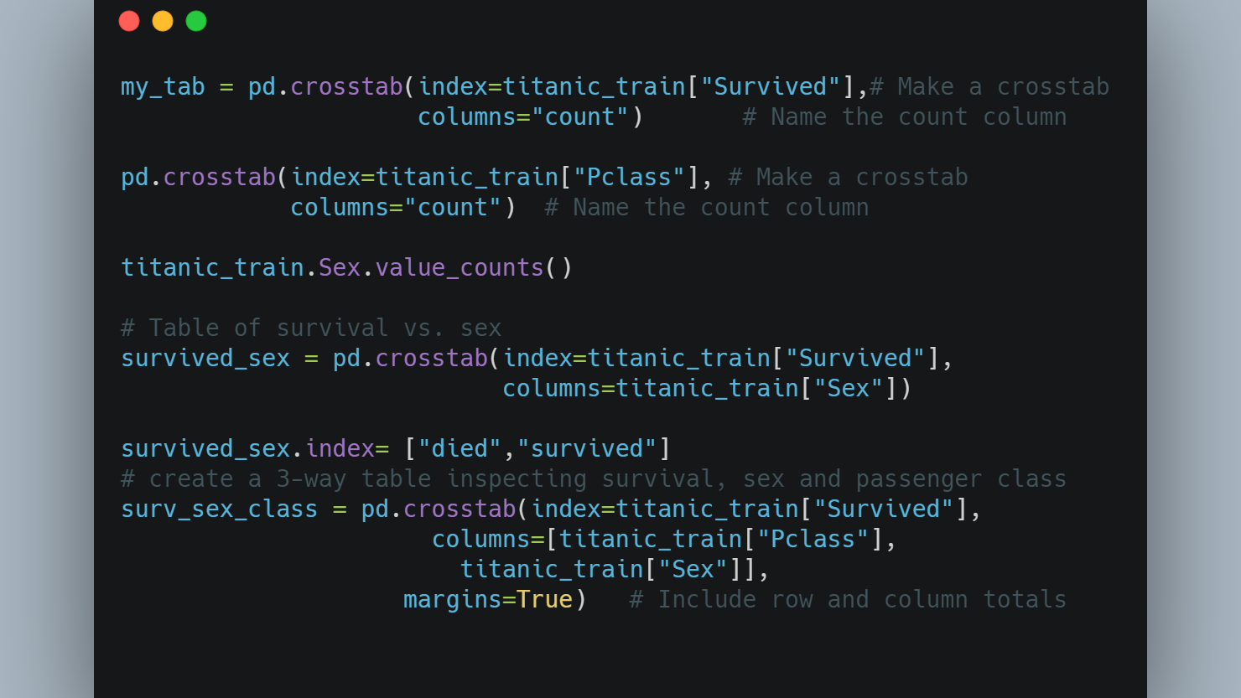

Slide 71
Pclass | 1 |  | 2 |  | 3 |  | All
Sex | female | male | female | male | female | male
Survived
0 | 3 | 77 | 6 | 91 | 72 | 300 | 549
1 | 91 | 45 | 70 | 17 | 72 | 47 | 342
All | 94 | 122 | 76 | 108 | 144 | 347 | 891

Slide 72
Pclass | 1 |  | 2 |  | 3 |  | All
Sex | female | male | female | male | female | male
Survived
0 | 0.031915 | 0.631148 | 0.078947 | 0.842593 | 0.5 | 0.864553 | 0.616162
1 | 0.968085 | 0.368852 | 0.921053 | 0.157407 | 0.5 | 0.135447 | 0.383838
All | 1.000000 | 1.000000 | 1.000000 | 1.000000 | 1.0 | 1.000000 | 1.000000

Slide 73
Plotting With Pandas
Visualizations are one of the most powerful tools at your disposal for exploring data and communicating data insights.
Plots in pandas are built on top of a popular Python plotting library called matplotlib

Slide 74
Histograms
A histogram is a univariate plot (a plot that displays one variable) that groups a numeric variable into bins and displays the number of observations that fall within each bin. A histogram is a useful tool for getting a sense of the distribution of a numeric variable.

Slide 75
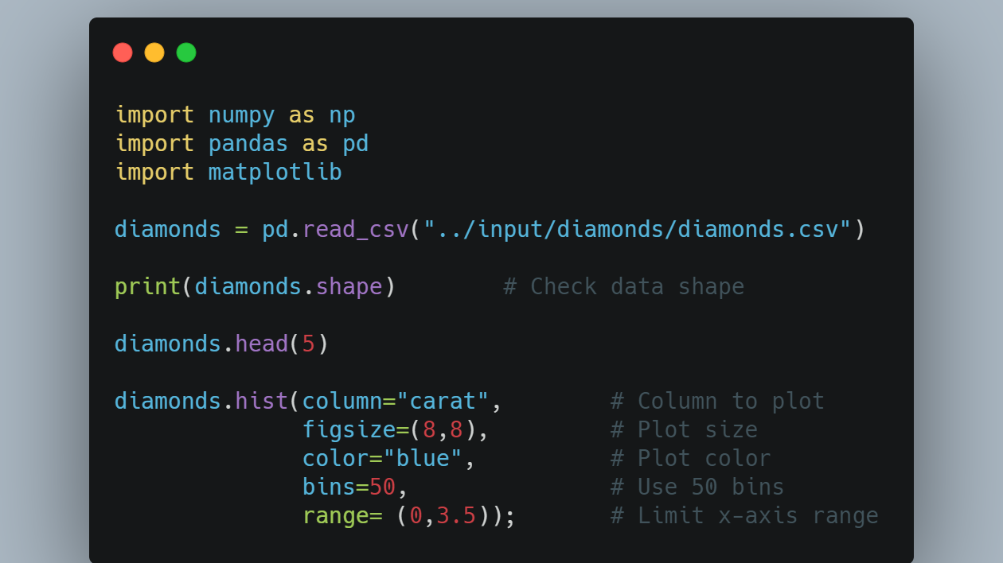

Slide 76
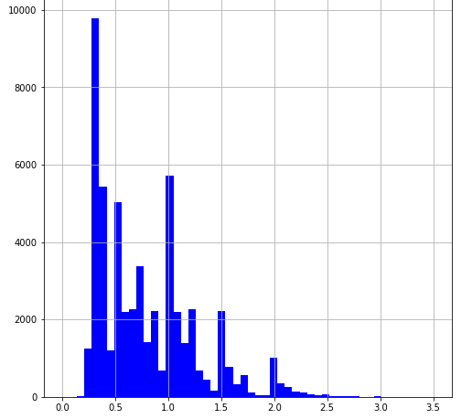

Slide 77

Boxplots
Boxplots are another type of univariate plot for summarizing distributions of numeric data graphically.
A side-by-side boxplot takes a numeric variable and splits it on based on some categorical variable, drawing a different boxplot for each level of the categorical variable.

Slide 78
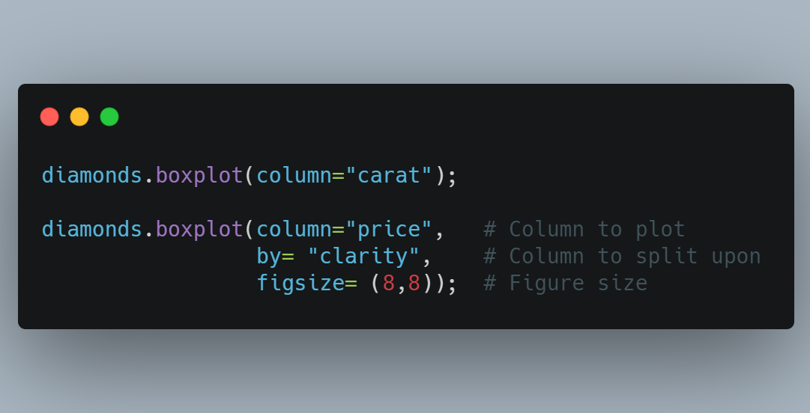

Slide 79
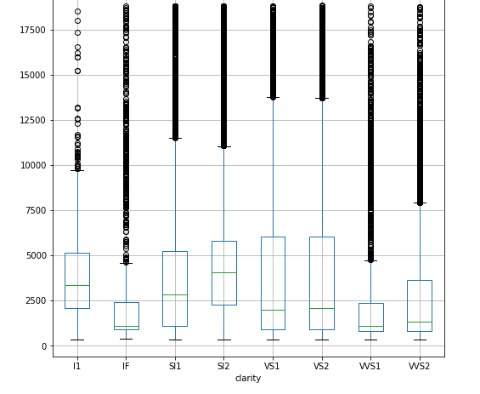

Slide 80
Density Plots
A density plot shows the distribution of a numeric variable with a continuous curve. It is like a histogram but without discrete bins.

Slide 81
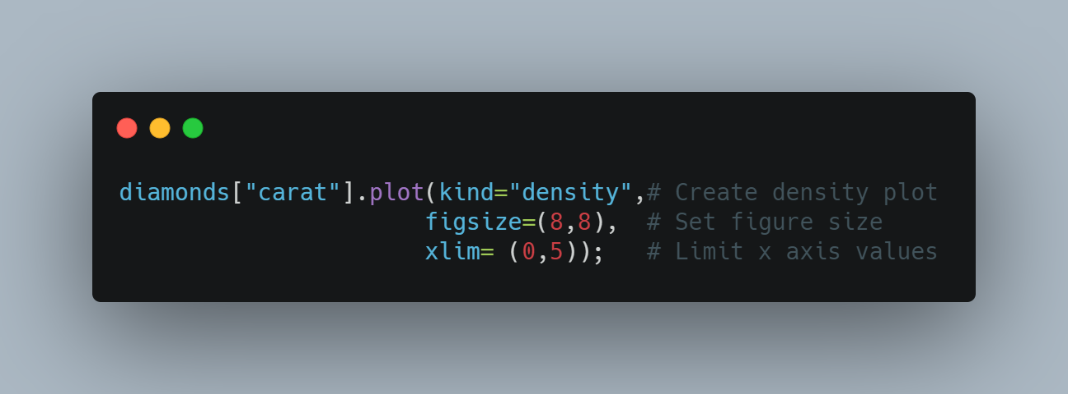

Slide 82
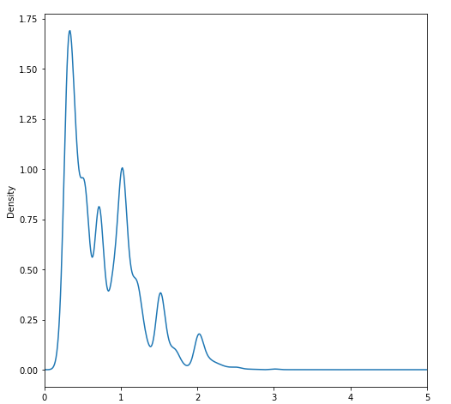

Slide 83
Barplots
Barplots are graphs that visually display counts of categorical variables.

Slide 84
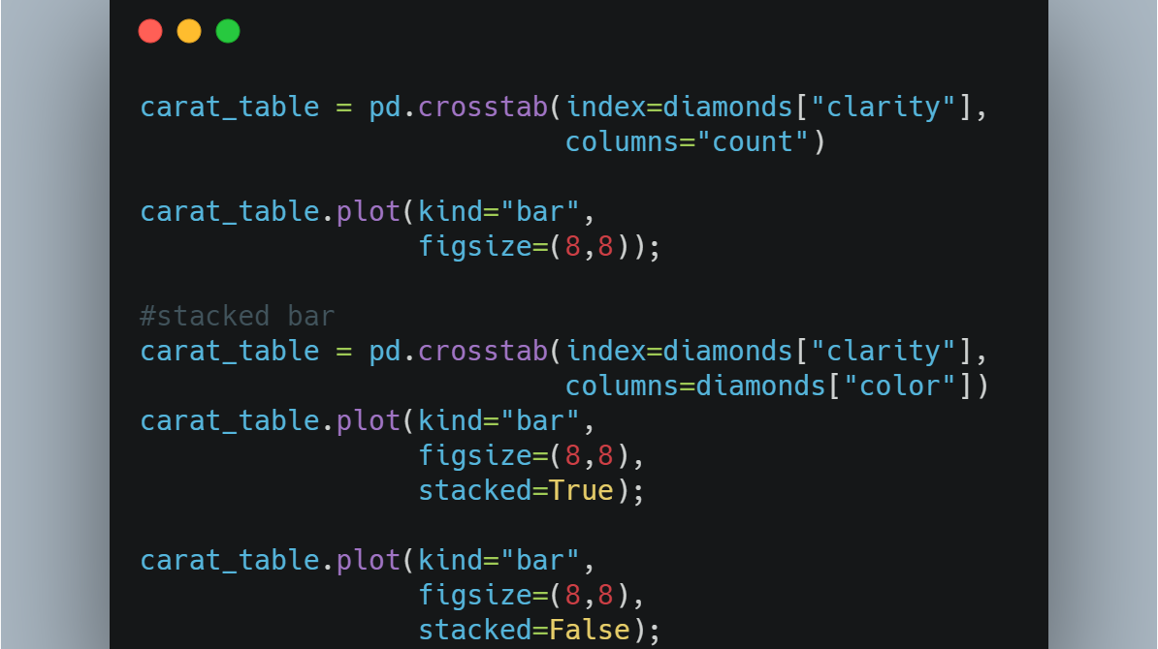

Slide 85


Slide 86


Slide 87


Slide 88
Scatterplots
Scatterplots are bivariate (two variable) plots that take two numeric variables and plot data points on the x/y plane.

Slide 89


Slide 90


Slide 91
Line Plots
Line plots are charts used to show the change in a numeric variable based on some other ordered variable.
Line plots are often used to plot time series data to show the evolution of a variable over time.

Slide 92


Slide 93


Slide 94


